Slide 1
Stroke prediction
MVP

Slide 2
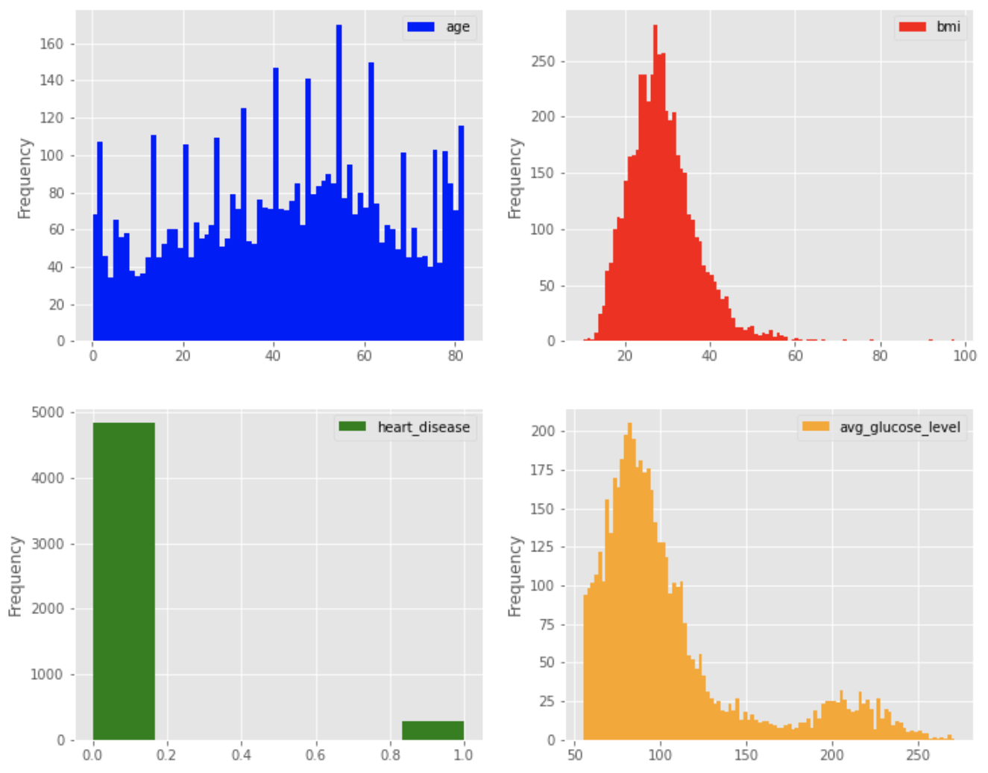
MVP
As a step in getting to our goal
The charts a side show’s the Variance features Distribution.

